Slide 1
Chapter 3:
Operating Systems
Computer Science: An Overview
Twelfth Edition
by
J. Glenn Brookshear
Dennis Brylow

Slide 2
Chapter 3: Operating Systems
3.1 The History of Operating Systems
3.2 Operating System Architecture
3.3 Coordinating the Machine’s Activities
3.4 Handling Competition Among Processes
3.5 Security
3-<number>

Slide 3
Functions of Operating Systems
Oversee operation of computer
Store and retrieve files
Schedule programs for execution
Coordinate the execution of programs
3-<number>

Slide 4
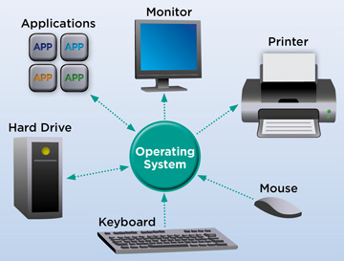
Functions of OS
3-<number>

Slide 5
Evolution of Shared Computing
Batch processing
Interactive processing
  Requires real-time processing
Time-sharing/Multitasking
  Implemented by Multiprogramming
Multiprocessor machines
3-<number>

Slide 6
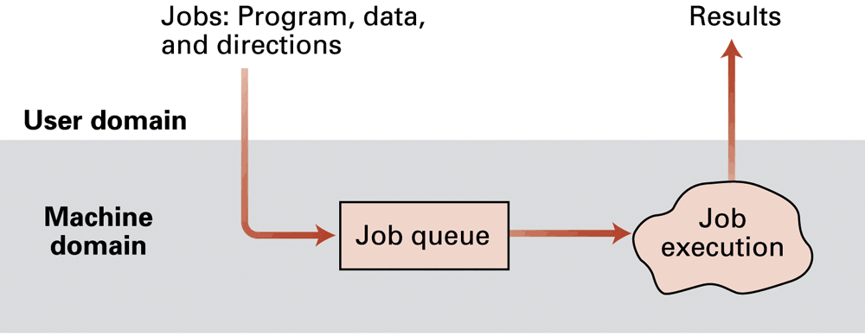
Figure 3.1 Batch processing
Job – Any command/ program
Job Queue – First In First Out (FIFO) strategy
No interaction with job (example: result processing, printing news articles)
3-<number>

Slide 7
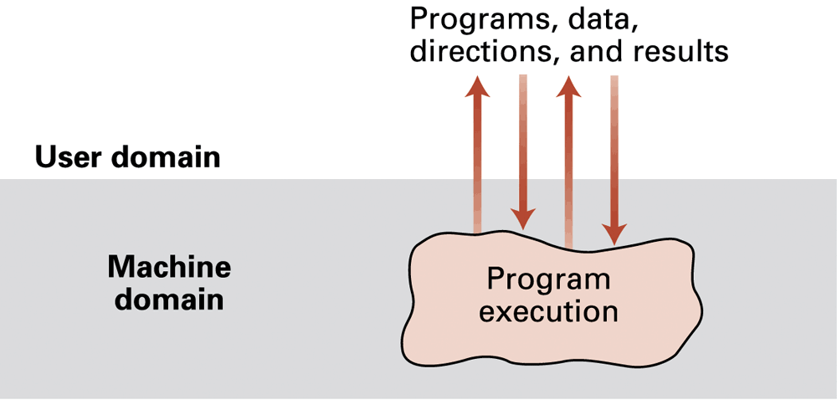
Figure 3.2 Interactive processing
a.k.a Real-time processing, take user input, process and show results
Single user – Multiple jobs – Multi tasking (Ex: using printer, using word, using paint, compiling mail, etc.) – many windows
3-<number>

Slide 8
Interactive processing
a.k.a Time Sharing: Multiple users – submit different jobs (not transparent to the user)
  Solution: multiprogramming in which time is divided into intervals and then the execution of each job is restricted to only one interval at a time
Multi Processors – More than one CPU
  load balancing -- dynamically allocating tasks to the various processors so that all processors are used efficiently
  scaling -- breaking tasks into a number of subtasks compatible with the number of processors available
3-<number>

Slide 9
Types of Software
Application software
  Performs specific tasks for users
System software
  Provides infrastructure for application software
  Consists of operating system and utility software
3-<number>

Slide 10
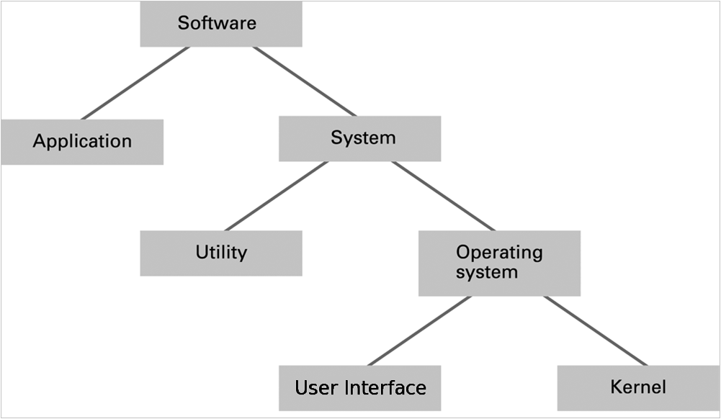
Figure 3.3 Software classification
3-<number>

Slide 11
Operating System Components
User Interface: Communicates with users
  Text based (Shell)
  Graphical user interface (GUI)
Kernel: Performs basic required functions
  File manager
  Device drivers
  Memory manager
  Scheduler and dispatcher
3-<number>

Slide 12
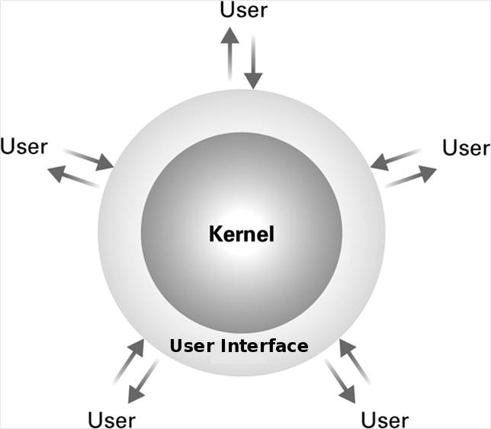
Figure 3.4 The user interface act as an intermediary between users and the operating system kernel
3-<number>

Slide 13
File Manager
Directory (or Folder): A user-created bundle of files and other directories (subdirectories)
Directory Path: A sequence of directories within directories
3-<number>

Slide 14
Memory Manager
Allocates space in main memory
May create the illusion that the machine has more memory than it actually does (virtual memory) by playing a “shell game” in which blocks of data (pages) are shifted back and forth between main memory and mass storage
3-<number>

Slide 15
Getting it Started (Bootstrapping)
Boot loader: Program in ROM (example of firmware)
  Run by the CPU when power is turned on
  Transfers operating system from mass storage to main memory
  Executes jump to operating system
3-<number>

Slide 16
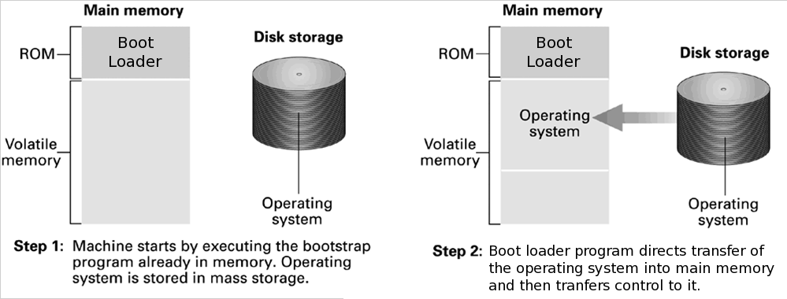
Figure 3.5 The booting process
3-<number>

Slide 17
Processes
Process: The activity of executing a program
Process State: Current status of the activity
  Program counter
  General purpose registers
  Related portion of main memory
3-<number>

Slide 18
Process Administration
Scheduler: Adds new processes to the process table and removes completed processes from the process table
Dispatcher: Controls the allocation of time slices to the processes in the process table
  The end of a time slice is signaled by an interrupt.
3-<number>

Slide 19
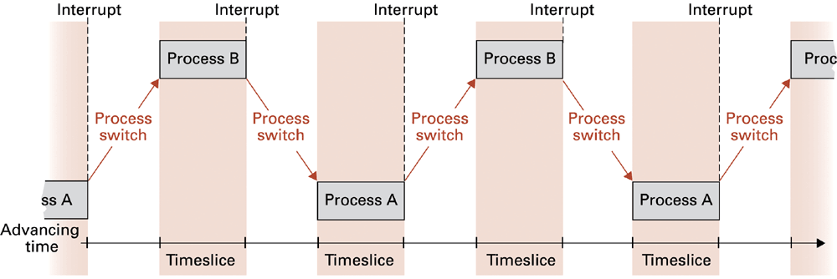
Figure 3.6 Time-sharing between process A and process B
3-<number>

Slide 20
Handling Competition for Resources
Semaphore: A “control flag”
Critical Region: A group of instructions that should be executed by only one process at a time
Mutual exclusion: Requirement for proper implementation of a critical region
3-<number>

Slide 21
Deadlock
Processes block each other from continuing
Conditions required for deadlock
  1. Competition for non-sharable resources
  2. Resources requested on a partial basis
  3. An allocated resource can not be forcibly retrieved
3-<number>

Slide 22
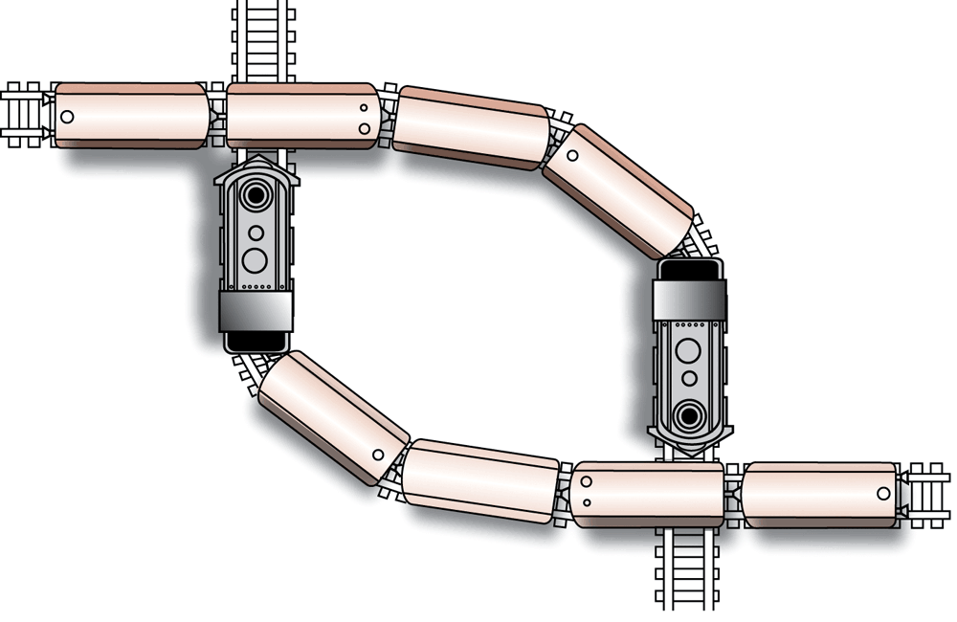
Figure 3.7 A deadlock resulting from competition for nonshareable railroad intersections
3-<number>

Slide 23
Security
Attacks from outside
  Problems
    Insecure passwords
    Sniffing software
  Counter measures
    Auditing software
3-<number>

Slide 24
Security (continued)
Attacks from within
  Problem: Unruly processes
  Counter measures: Control process activities via privileged modes and privileged instructions
3-<number>

